Slide 1
Respect for People: The Foundation Courses
Fundamentals of Communication Emotional Intelligence
Presented by:
Pat Hein and Travis Ramage,
Organizational Development Consultants with UW Health
Envisioning Our Future
Fundamentals of Communication
Emotional Intelligence
Notes:
Content for NLO/UWHW Hybrid
Total Time: 110 minutes
Time: 1 min used / 119 min remaining
Welcome everyone
(1 minutes)
SAY: We started with the R4P commitments, and now we are focusing on Fundamentals of Communication to help support the commitments and behaviors. We will round out our foundation with Emotional Intelligence. For now let’s take a look at Fundamentals of Communication.
Please have the workbook on hand as we travel through Fundamentals of Communication and Emotional Intelligence.
Facilitator Note:
When creating the Breakout Groups for the Fundamentals of Communication Scenarios and Emotional Intelligence Elements use the following naming convention for the groups:
Scenario 1/Self-Awareness
Scenario 2/Self-Management
Scenario 3/Social Awareness
Scenario 4/Relationship Management
OR
Scenario 1/Self-Awareness
Scenario 1/Self-Management
Scenario 3/Social Awareness
Scenario 3/Relationship Management

Slide 2
Strategic Playbook
Notes:
Time: X min used / XX min remaining
SAY: Our UW Health strategic playbook is connected to the existing mission of Patient Care, Education, Research and Community Service and focused on our vision of remarkable health care. Within our playbook we have one area we are focusing on today -- your professional development, which impacts your overall wellbeing.

Slide 3
70-20-10 Learning Model
10%
Formal Learning
Learning courses, certifications, continuing education, reading a book
70%
Learning from Experience
20%
New responsibilities, tasks, project assignment
Learning from Others
Go and Sees, coaching, mentoring, observing others, soliciting feedback
Notes:
Time: 2 min used / XX min remaining
Purpose of slide
Sharing of the learning model used by OD, discussion of specific use in this offering
Talking Points
The 70-20-10 rule reveals that individuals tend to learn 70% of their knowledge from challenging experiences and assignments, 20% from developmental relationships, and (CLICK) 10% from coursework and training.

Slide 4
Learning Agreements
Purpose: To provide an environment that encourages and supports the learning for everyone.
Seek opportunities for personal growth
Be engaged in the learning experience
Foster inclusivity in all aspects of learning
Ask questions and consider others’ ideas
Actively listen and remain present
Show appreciation for others’ ideas
Notes:
Time: 1 min used / 117 min remaining
SAY: Here are the Learning Agreements that you have all become familiar with. By acknowledging to these agreements, we are providing a safe environment that encourages and supports the learning and growth of everyone. As always, we are staying embedded in the Respect for People commitments as the foundation of the way we work. Please review these agreements. Are there any other agreements you believe should be added to this list?
CLICK
In essence, this is Respect for People

Slide 5
Learning Objectives
Page 2
Identify the communication styles that are consistent with the Respect for People Behaviors
Apply Emotional Intelligence strategies to positively impact the Respect for People commitments and their associated behaviors
Using the Respect for People Commitments, and the Fundamentals of Communication, apply assertive communication skills and behaviors in specific scenarios
Notes:
Time: 1 min used / 116 min remaining
Read slide
Go through the objectives on this slide.
As always, we appreciate your participation and feedback. At the end of our session today we will be conducting a survey to determine how we did. We will be asking a few simple questions on content, how much was presented and if it hit the mark. We value your input. It allows us to continually improve and refine content to meet the needs.

Slide 6
What stood out for you from the Prework?
Notes:
Time: 2 min used / 115 min remaining
SAY: Who would like to unmute and share a little bit about what stood out for you in the Prework.
CLICK
If you prefer, you may also type in the chat.

Slide 7
How You Say, What You Say
Notes:
Time: 2 min used / 113 min remaining
SAY: Let’s take a look at a short video that demonstrates how you say what you say…
Link: https://www.youtube.com/watch?v=0-7Ucg5GKnw
Debrief:
What stood out for you in the video?
What was the overall impression in the scenario with the girl?
What was the overall impression in the scenario with the man?
How did the body language and tone contribute to each of the scenarios?

Slide 8
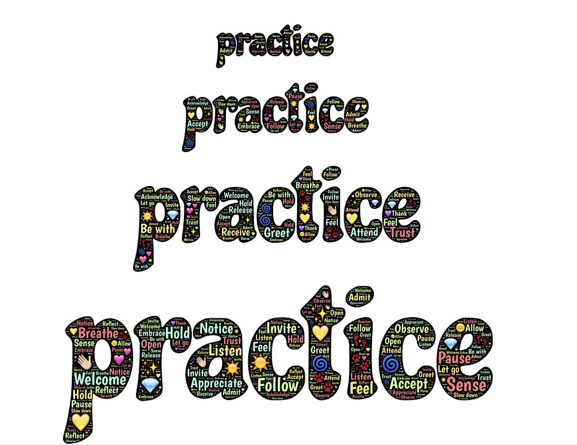
Communication Warm-Up
Page 2
Directions: Say the word “Oh” differently, giving it the following meaning or tone each time.
Shock
Doubt
Displeasure
Detachment
Resentment
Surprise
Meaning the letter in the alphabet between “n” and “p”
Notes:
Time: 3 min used / 110 min remaining
Activity: Ask for volunteers to pick a meaning and say the word “oh” while the other members in the group guess the meaning. (2-3 volunteers with guessing by the group based on time)
Directions: Say the word “Oh” differently, giving it the following interpretation or meaning each time:
Shock
Doubt
Displeasure
Detachment
Resentment
Surprise
Meaning the letter in the alphabet between n and p
Facilitator Note:
Emphasize just how important the way we say things is to the meaning that is communicated to others.
1. It has been shown that this dimension of voice inflections comprises approximately 38% of the message received.
2. It becomes obvious that what we say isn’t nearly as important as how we say it. However, we don’t typically focus on this dimension of communications as much as we should.
3. Too often we are much more concerned about what we are going to say rather than how we are going to deliver the message. However, paying closer attention to how people communicate can provide extremely valuable information about how they really feel.

Slide 9
The Full Impact of a Message
Page 2
? %
Spoken Word
Expression & Tone 38%
Expression/Tone
? %
? %
Body Language
Notes:
Time: 2 min used / 108 min remaining
ASK: What % of the message is the words we say? Put you guesses in the Chat.
SAY: We can see that the words we speak have the least impact on the message, so it really does become about ‘how we say what we say’.
Transition: Let’s take a look now at different communication styles.
CLICK

Slide 10
Communication Style Interactions
Page 3
Aggressive
Passive
Assertive
Passive-Aggressive
Notes:
Time: 5 min used / 103 min remaining
SAY: These are 4 basic communication styles we may experience depending on the situation we are in. Using an assertive communication style is a learned behavior based on our abilities that we develop over time with practice. We are going to use the weather as a metaphor to understand the 4 different styles.
CLICK
Aggressive: This style of communicating can be compared to a loud, intimidating, and scary thunderstorm.
CLICK
Passive-Aggressive: This style of communicating, can be compared to a quiet, but ominous and threatening sky before a storm.
CLICK
Passive: This style of communicating can be compared to a misty, foggy day, hanging low in the background.
CLICK
Assertive: This style of communicating can be compared to a steady rain, providing the moisture needed to support the growth of those around us.
Let’s dive a little deeper into each of the styles, looking at the characteristics and body language associated with each style.

Slide 11
Aggressive
Page 3
What are the characteristics of aggressive communication style?
Uses power, creating an impression of superiority
Intimidates, blames, judges, which may impact the feelings of others
Controls the environment to suit their needs
What body language represents this style?
Leaning forward with glaring eyes
Pointing a finger, clenching fists
Crossing arms, or “cold” demeanor
“My rights and needs are more important”
Notes:
Facilitator:
1 min used / 102 min remaining
SAY: Aggressive is …”My rights and needs are more important.” Knowing that, what are some characteristics of a person with an aggressive communication style?
<click>
What are the characteristics of aggressive communication style?
Uses power, creating an impression of superiority
Intimidates, blames, judges, which may impact the feelings of others
Controls the environment to suit their needs
<click>
What does the body language look like for aggressive behavior?
<click>
Leaning forward with glaring eyes.
Pointing a finger at the person to whom you are speaking.
Crossing arms, combined with other verbal/non-verbal communication could be seen as aggressive
Shouting.
<click>

Slide 12
Passive-Aggressive
Page 3
What are the characteristics of passive-aggressive communication style?
Tends to not tell others when something is bothering them
Blames others; shows self-pity
Uses sarcasm and put-downs
Avoids direct response or uses one-word answers
What body language represents this style?
Smirks, false warmth
Mixed body language
Eye-rolling
“I subtly make sure that my rights and needs prevail”
Notes:
Facilitator:
Time: 1 min used / 101 min remaining
SAY: Passive-Aggressive is …”I subtly make sure that my rights and needs win.” Knowing that, what are some characteristics of a person with an aggressive behavior?
<click>
What are the characteristics of passive-aggressive communication style?
Tends to not tell others when something is bothering them
Blames others; shows self-pity
Uses sarcasm and put-downs
Avoids direct response or uses one-word answers
<click>
What does the body language look like for passive aggressive style?
<click>
Smirks, false warmth
Mixed body language
Eye-rolling

Slide 13
Passive
Page 3
What are the characteristics of passive communication style?
Avoids conflict, indecisive
Afraid to upset the relationship
Allows the wants and needs of others to be more important
What body language represents this style?
Lack of eye contact; looks down or away
Speaks softly or apologetically or lack of response
Withdraws from an uncomfortable conversation
“Others’ rights are more important than mine”
Notes:
Facilitator:
Time: 1 min used / 100 min remaining
SAY: A definition of Passive is…”others rights are more important than mine.” Keeping this definition in mind, what are some characteristics of passive behavior?
What are the characteristics of passive communication style?
Avoids conflict, indecisive
Afraid to upset the relationship
Allows the wants and needs of others to be more important
What body language represents this style?
[Ask before revealing]
What body language represents this style?
Lack of eye contact; looks down or away
Speaks softly or apologetically or lack of response
Withdraws from an uncomfortable conversation

Slide 14
Assertive
Page 3
What are the characteristics of assertive communication style?
Acts in one’s own best interest without violating the rights of others
Stands up for needs of self and others
Expresses feelings respectfully
What body language represents this style?
Displays confidence, directly facing the individual
Speaks fluently in a clear and steady voice
Maintains appropriate eye contact
“I clearly express that we both have rights and needs”
Notes:
Facilitator:
Time: 2 min used / 98 min remaining
SAY: A definition of assertiveness… “I clearly express that we both have rights and needs.”
What are the characteristics of assertive communication style?
Acts in one’s own best interest without violating the rights of others
Stands up for needs of self and others
Expresses feelings respectfully
<click>
What body language represents this style?
Displays confidence, directly facing the individual
Speaks fluently in a clear and steady voice
Maintains appropriate eye contact

Slide 15
Benefits of an Assertive Communication Style
Page 4
Allows us to demonstrate the Respect for People Commitments
Enables us to reach mutual understanding
Helps us get what we need/want to achieve goals
Allows us to be consistent and build respectful relationships with others
Enables us to express both positive and constructive verbal and nonverbal communication
Enhances self-esteem, confidence, and credibility
Notes:
Time: 2 min used / 96 min remaining
SAY: An assertive communication style allows use to demonstrate the Respect for People Commitments. We are able to Engage and Own It, Appreciate and Encourage, Listen to Understand, Connect with Others and Be Accountable.
Enables us to reach mutual understanding
Helps us get what we need/want to achieve goals
Allows us to be consistent and build respectful relationships with others
Enables us to express both positive and constructive verbal and nonverbal communication
Enhances self-esteem, confidence, and credibility

Slide 16
Responding to Non-Assertive Communication
How should you respond when others are communicating aggressively? Or passively?
PAUSE
Non-Assertive Behavior
Respond
Notes:
Facilitator:
Time: 1 min used / 95 min remaining
ASK: So how to we respond to others who are not communicating in an assertive style?
SAY: Instead of reacting, we want to respond. This is how we develop respectful relationships and get the outcomes we want.
Before we take a look at how to respond in a respectful, assertive manner, let’s review some tips for the pause.
CLICK

Slide 17
Tips for the “Pause”
Page 4
Breathe
Think about what you would like to say and how you would like to say it.
Ask permission to start the conversation
“Would it be okay if we talked about…”
“Do you mind if we discussed…”
“Might I add some thoughts here?”
Notes:
Time: 2 min used / 93 min remaining
SAY: Here some Tips for the Pause.
Click
Breathe. Of course, we always want to assume good intent, this is one way we Connect with Others. Maybe the person is having a bad day, maybe they misspoke or perhaps you didn’t hear or understand correctly. Whatever the case, the pause gives you time to manage your emotions and consider the response. Remember, too, from the prework, that Employee Wellbeing has an exercise called BOP- (breathe, observe, proceed) where you can walk through an exercise to help refocus, recharge and reduce you stress levels.
Click
The pause gives you the opportunity to think about what you would like to say and how you would like to say it.
Click
One way to start the conversation is to ask permission. This can be likened to knocking on a door before you enter the room.
Ask permission to start the conversation- Goes along with engage and own it, ask questions and speak up.
“Would it be okay if we talked about…”
“Do you mind if we discussed…”
“Might I add some thoughts here?”

Slide 18
Responding to an Aggressive Communication Style
Page 4
“Pause”
Use the Respect for People Commitments as your foundation
Demonstrate Listen to Understand
Remain present, actively listen
Treat with kindness and empathy
Maintain appropriate eye contact, focus on the other person
Confirm understanding
Be clear
Use “I” statements and avoid making accusations
Keep your body language positive
Notes:
Time: 1 min used / 92 min remaining
(Read Slide)
SAY: As previously stated, we want to respond rather than react to encourage assertive communication style and always use the Respect for People Commitments as our foundation.

Slide 19
Responding to a Passive Communication Style
Page 4
“Pause”
Connect with Others
Use a pleasant, caring and sincere tone of voice
Show empathy and compassion when acknowledging others’ emotions
Ask open-ended questions to consider others’ ideas and perspectives
Appreciate and Encourage
Support and inspire others to participate
Thoughtfully recognize others
Notes:
Time: 1 min used / 91 min remaining
SAY: When responding to passive communication, ineffective responses include ignoring the passive behavior and assuming everything is okay. Instead, we want to practice the following Respect for People Commitments to engage someone who is demonstrating passive communication behaviors.
For examples..
Connect with Others
Appreciate and Encourage

Slide 20
Page 5
Notes:
Time: 1 min used / 90 min remaining
SAY: Lets connect the Fundamentals of Communication content and strategies back to the Respect for People commitments and behaviors. You will see we highlighted one of the behaviors for commitment that align with a communication strategy we just discussed.

Slide 21
Page 6
Notes:
Time: 1 min used / 89 min remaining
SAY: Here are additional behaviors we highlighted that align with a communication strategy we just discussed.

Slide 22
Group Activity
Page 7
Within your assigned group, determine a response for your group’s assigned scenario using an Assertive communication style.
Notes:
Time: 10 min used / 79 min remaining
Breakout Rooms:
We are going to put you into random breakout rooms for 8 minutes.
The name of your Breakout Room will be the Scenario that we would like you to discuss. You will also be in this same Breakout Room for the Emotional Intelligence Breakout activity later in the session. As a result, you see a Scenario number and an Emotional Intelligence element as part of the name for your Breakout Room.
The Scenario information for this activity is on page X in your Participant Workbook
Identify who will be your group presenter. This person should take notes on what the group discusses.
Each group will present this information to the larger group.
SAY: Practice the assertive communication style, with the scenario assigned to your breakout room. These scenarios are on page 7 in your workbook. In about 8 minutes, we will discuss as a large group.
<Discussion> About 7 minutes

Slide 23
Scenario 1
Page 7
Your clinic manager looked at your schedule and asked you to open an additional clinic day. You don’t like to make waves, but you had already promised to attend an event with a friend who really needs your support.
Using the Respect for People Commitments and/or the communication strategies we just covered, how would you respond using an Assertive style?
Notes:
Facilitator: Debrief
Note: Alter scenario to make it work for you.
Time: 1 min used / 78 min remaining
SAY: Which communication style best describes this team member? Answer: Passive
Debrief the rest of the scenario using the appropriate breakout room spokesperson.

Slide 24
Scenario 2
Page 7
You are in a meeting during which your team is discussing changes to a workflow. You have firsthand experience with the process which, from your perspective, is currently working well. You are feeling annoyed, as some of the strongest opinions for change are being offered by those farthest from the work. You would like to share your feedback in a clear, respectful way.
Using the Respect for People Commitments and/or the communication strategies we just covered, how would you respond using an Assertive style?
Notes:
Time: 1 min used / 77 min remaining

Slide 25
Scenario 3
Page 7
You are in a meeting with your colleagues and noticed that one team member is aggressively sharing their opinion on a situation while others are passively listening to the conversation. You want to make sure everyone has an opportunity to share their thoughts on the topic.
Using the Respect for People Commitments and/or the communication strategies we just covered, how would you respond using an Assertive style?
Notes:
Time: 1 min used / 76 min remaining

Slide 26
Scenario 4
Page 7
You are informed that a patient in the waiting room is visibly upset and being very loud. Their actions are also making others uncomfortable. You are concerned for the patient’s well-being, as well as for those around them.
Using the Respect for People Commitments and/or the communication strategies we just covered, how would you respond using an Assertive style?
Notes:
Time: 1 min used / 75 min remaining
SAY: (after discussing the four scenarios) Nice job. I think you all get the idea. We have and make choices on how we communicate every day. It’s important to stay embedded into the Commitments (i.e., Listen to Understand. Connect with Others, etc)

Slide 27
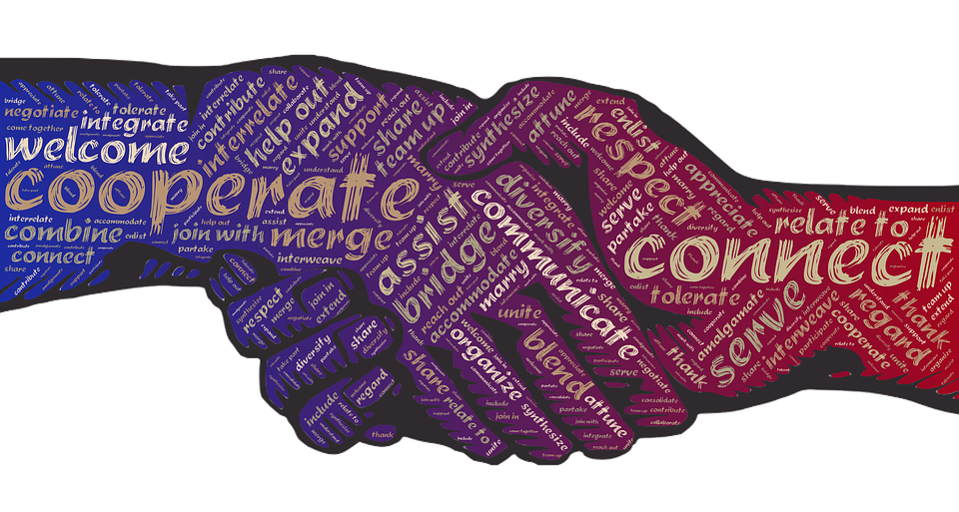
Why is Respectful Communication Important?
Page 8
Good communication with patients, families, and other healthcare team members is a critical skill for all teams
Good Communication...
Helps prevent errors and keeps patients safe
Leads to much better outcomes for our patients
Contributes to a positive patient experience
Cultivates working relationships
Fosters a healthy working environment
Minimizes stress
Supports Diversity, Equity, and Inclusion
Notes:
Time: 2 min used / 73 min remaining
SAY: Good communication with patients, families, and other healthcare team members is a critical skill for all teams
CLICK
ASK: Why is good communication important? Ask 1-2 participants to unmute and share
CLICK to share list of reasons

Slide 28
What is one key takeaway so far?
Notes:
Time: 1 min used / 72 min remaining
SAY: Type one key takeaway in the chat.
Thank you for sharing. If you would like more resources, they can be found on U-Connect:
Respect for People Suite of Activities and Resources
Respect for People in Action

Slide 29
Time for a Break
Notes:
Time: 5 min used / 67 remaining
Play the accordion

Slide 30
Objectives
Identify the communication styles that are consistent with the Respect for People Behaviors
Using the Respect for People Commitments, and the Fundamentals of Communication, apply assertive communication skills and behaviors in specific scenarios
Apply Emotional Intelligence strategies to positively impact the Respect for People commitments and their associated behaviors
Notes:
Time: 1 min used / 65 min remaining
Read slide
Go through the objectives on this slide.
As always, we appreciate your participation and feedback. At the end of our session today we will be conducting a survey to determine how we did. We will be asking a few simple questions on content, how much was presented and if it hit the mark. We value your input. It allows us to continually improve and refine content to meet the needs.

Slide 31
What was a take-away from the Pre-Work?
Notes:
Time: 2 min used / 63 min remaining
Go ahead and unmute or type in the chat.
Key points from pre-work
1. EI is the other kind of smart. People with average IQ’s outperform those with highest IQ’s 70% of the time. EI is the critical factor that sets star performers apart from the pack.
2. Your emotional intelligence is the foundation for a host of critical skills—it impacts most everything you say and do each day. Emotional intelligence is the single biggest predictor of performance in the workplace and the strongest driver of leadership and personal excellence.
The four EQ skills (self-awareness, self-management, social awareness, and relationship management) are intertwined in most everything we do and say at work. It is possible to train the brain when we practice EI.
Self-Awareness is your ability to accurately perceive your emotions and stay aware of them as they happen.
Self-Management is your ability to use awareness of your emotions to stay flexible and positively direct your behavior.
Social Awareness is your ability to accurately pick up on emotions in other people and understand what is really going on.
Relationship Management is your ability to use awareness of your emotions and the others’ emotions to manage interactions successfully.
2/3 of us are typically controlled by our emotions and not yet aware of how to identify or use our emotions to our benefit.

Slide 32
What is Emotional Intelligence?
The ability to recognize our own and others’ feelings and emotions and to use this information to guide thinking and actions.
PAUSE
Something Happens
I Act
Notes:
Time: 1 min used / 62 min remaining
Facilitator Note: Ask someone to read the Emotional Intelligence definition.
SAY: Emotional Intelligence helps us to avoid being taken over by our emotional life. We are better able to persist in the face of challenges. In the end, if you have emotional intelligence, you are better able to read other’s emotions which helps handle feelings in relationships. The ability to express and control our own emotions is important, but so is our ability to understand, interpret, and respond to the emotions of others.
CLICK
You will see this image of Something Happens – Pause – I Act. We will be using this image today as we provide tools and strategies to use in the Pause before you act/respond. In this instance, you are pausing to recognize the feelings and emotions of both you, and the other person/people you are engaging with before you act/respond
CLICK

Slide 33
Tips for the “Pause”
Breathe
Think about what you would like to say and how you would like to say it.
Ask permission to start the conversation
“Would it be okay if we talked about…”
“Do you mind if we discussed…”
“Might I add some thoughts here?”
Notes:
Time: 1 min used / 61 min remaining
SAY: Here some Tips for the Pause.
CLICK
Breathe. Of course, we always want to assume good intent, this is one way we Connect with Others. Maybe the person is having a bad day, maybe they misspoke or perhaps you didn’t hear or understand correctly. Whatever the case, the pause gives you time to manage your emotions and consider the response. Remember, too, from the prework, that Employee Wellbeing has an exercise called BOP- (breathe, observe, proceed) where you can walk through an exercise to help refocus, recharge and reduce you stress levels.
CLICK
The pause gives you the opportunity to think about what you would like to say and how you would like to say it.
CLICK
One way to start the conversation is to ask permission. This can be likened to knocking on a door before you enter the room.
Ask permission to start the conversation- Goes along with engage and own it, ask questions and speak up.
“Would it be okay if we talked about…”
“Do you mind if we discussed…”
“Might I add some thoughts here?”

Slide 34
Elements of Emotional Intelligence
Page 9
Self-Awareness
Self-Management
Personal
PAUSE
Something Happens
I Act
Emotional Intelligence
Social Awareness
Relationship Management
Social
Source: Bradberry, T. and Greaves, J. (2009). Emotional Intelligence 2.0. San Diego: TalentSmart
Notes:
Time: 3 min used / 58 min remaining
Something happens, I act. That happens when there is no pause. Today we are going to spend some time looking at the Elements
CLICK of EI and what the pause consists of.
This information is from Emotional Intelligence 2.0 by Bradberry and Greaves and can be found on page 2 of your participant workbook.
In this model of EI there are four skills, or elements, and two qualities, or competencies.
The first competency is Personal,
CLICK
made up of Self-Awareness and Self-Management. These two elements focus on you individually, rather than your interactions with others and have to do with recognizing and effectively managing your own emotions and behavior.
The other two elements, Social Awareness and Relationship Management are part of the Social competency.
CLICK
These elements focus on your ability to understand other people’s moods, behaviors, and motives in order to improve the quality of your relationships.
Emotional Intelligence is the product of the amount of communication between the logical and emotional centers of your brain. When you practice Emotional Intelligence, it strengthens these pathways, developing connections between your feelings and reason. This takes time, but with practice, you can make the path between the emotional and logical centers of your brain well-travelled, therefore improving your Emotional Intelligence.
We are going to take a closer look at these different elements using a breakout room activity.
CLICK

Slide 35
Small Group Activity
Page 9-10
Self-Awareness
Self-Management
Within your group, review the information on your assigned element and be prepared to share the following:
How would you explain this element?
Why is this important as you demonstrate the Respect for People commitments and the associated behaviors?
Emotional Intelligence
Social Awareness
Relationship Management
Notes:
Time: 12 min used / 46 min remaining
SAY: Before we dive into the detail of each element, we are going to put each of you into an “expert group” to help provide an overview for one of the elements and share the highlights of that discussion when we come back to the main room.
CLICK
ACTIVITY: In your Breakout Group, you will have 10 minutes to review the document and prepare a teach back to the rest of the group on your assigned element(s). During this time, you should 1) review your assigned EI element(s) as a group, 2) prepare what you want to share, and 3) designate someone in your group to speak. Once we are back in the main room, each group will provide an overview of their element(s) and how it connects to the R4P commitments.
DIRECTIONS:
We are going to break the class back into four Breakout Groups, assigning each group to one of the elements.
As we mentioned earlier, the name of your group’s assigned Emotional Intelligence element is in the title of your Breakout Room
Review the information on pages 2-3 in your Participant Workbook
Prepare a brief teach back on your element, considering the two questions on the screen.
Identify who will be your group presenter. This person should take notes on what the group discusses.
Each group will present this information to the larger group when we review your individual element throughout the rest of the class.

Slide 36
Self-Awareness
Page 10
How would you explain this element?
Why is this important as you demonstrate the Respect for People commitments and the associated behaviors?
Notes:
Time: 3 min used / 43 min remaining
SAY: We are going to start our EI discussion with the Self-Awareness element.
Facilitator Note:
For smaller group, ask each group to report out their responses for Q1 and Q2.
For larger groups, where two (2) groups are assigned to each EI element,
ASK: Would the spokesperson from Group 1 please share your group’s responses to Question 1?
ASK: Would the spokesperson from Group 2 please share your group’s responses to Question 2?
<CLICK>

Slide 37
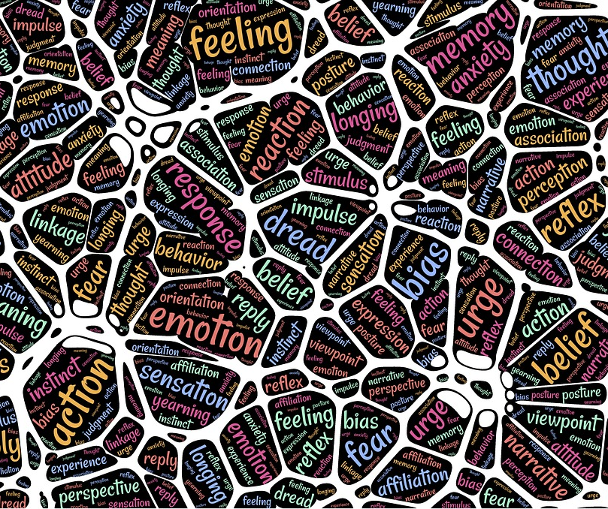
Self-Awareness
Page 9
Ability to accurately perceive your own emotions in the moment and understand your tendencies across situations
e.g., effectively identifying your feelings in the moment, rather than immediately sending an emotionally charged response in an email
Notes:
Time: 1 min used / 42 min remaining
SAY: This quality is the foundation of EI and fundamental to our decision making. Being aware of our changing moods allows us to step back and think before we make an impulsive decision or provide an impulsive response.
Facilitator Note: Read some of the emotions being shared in Chat.

Slide 38
Self-Awareness Strategies
Page 11
Observe the ripple effect from your emotions
Lean into your discomfort
Stop and ask yourself why you do the things you do
Seek feedback
Get to know yourself under stress
Notes:
Time: 2 min used / 40 min remaining
ASK: As we finish our discussion on this element, what are some strategies that can be used to develop Self-Awareness? Please post your ideas in Chat.
SAY: Here are some strategies from the Bradberry and Greaves book that can be used to develop the Self-Awareness skill:
Facilitator Note: If there is not enough time to cover all of the points under each strategy, focus on sharing the content in italics.
Observe the ripple effect from your emotion.
Watch closely how your emotions impact other people immediately, and then use that information as a guide for how your emotions affect a wider circle.
Since emotions are the drivers of behavior, it’s important to understand the effect they have on other people.
Spend time reflecting on your behavior and consider asking others how they are affected by your emotions.
Lean into your discomfort.
Just thinking about your emotions will help you change. When you ignore or minimize an emotion, you miss the opportunity to do something productive with that feeling.
After the first few times of leaning into your emotions, you will find that the discomfort isn’t so bad, it doesn’t ruin you, and it could be rewarding.
Stop and ask yourself why you do the things you do
Ask yourself why surprising emotions came to the surface and what motivated you to do something out of character.
Emotions happen when they will, not when you will them to.
Emotions clue us into things that you will never understand if you don’t take the time to ask yourself why.
Just taking time to pay attention to your emotions and asking yourself why are enough to help you improve.
Seek feedback
The only way to gain an inside and outside perspective of yourself is to open yourself up to feedback from others.
Everything you see, including yourself, is through your lens.
However, your lens prevents you from obtaining a truly objective look at yourself.
There is often a big difference between how you see yourself and how others see you.
We will be discussing strategies for giving and receiving feedback in the next session, including how to ask for specific examples and situations.
Get to know yourself under stress
Each of our bodies and minds responds differently to stress. Some of us get an upset stomach, while other may get headaches, back pain, or other physiological reactions to stress. We need to learn to listen to what are bodies are telling us.
You will significantly benefit from learning to recognize your first signs of stress.
Your mind and body will let you know when it’s time to slow down and take break. The challenge is listening!
Take the time to recognize your body’s signals and recharge your emotional battery before permanent damage is done to your system.

Slide 39
Self-Management
Page 10
How would you explain this element?
Why is this important as you demonstrate the Respect for People commitments and the associated behaviors?
Notes:
Time: 3 min used / 37 min remaining
Facilitator Note:
For smaller group, ask each group to report out their responses for Q1 and Q2.
For larger groups, where two (2) groups are assigned to each EI element,
ASK: Would the spokesperson from Group 3 please share your group’s responses to Question 1?
ASK: Would the spokesperson from Group 4 please share your group’s responses to Question 2?
<CLICK>

Slide 40
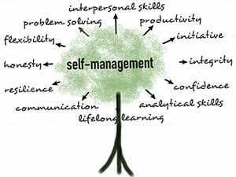
Self-Management
Page 9
Ability to use your self-awareness of your emotions to stay flexible and direct your behavior positively
e.g., take time to reflect and/or walk away from a stressful situation rather than making a decision in the heat of the moment.
Notes:
Time: 1 min used / 36 min remaining
SAY: This element helps us to make wise choices despite the pull of powerful emotions. Acknowledging this skill can prevent you from making critical decisions during time of high drama. It is best to wait for the inner storm to calm, choose your attitude, and then make a considered choice that will lead to your desired outcome and experiences.

Slide 41
Self-Management Strategies
Page 11
Breathe right
Make your goals public
Talk to a skilled self-manager
Learn a valuable lesson from everyone you encounter
Be open to change
Notes:
Time: 3 min used / 33 min remaining
ASK: As we finish our discussion on this element, what are some strategies to use to develop Self-Management? Please post your ideas in Chat.
SAY: Here are some strategies that can be used to develop the Self-Management skill:
Facilitator Note: If there is not enough time to cover all of the points under each strategy, focus on sharing the content in italics.
Breathe right
So…the next time you are in stressful or emotional situation, focus in taking deep breaths, inhaling through your nose until you feel your stomach swell outward, and then exhale gently through your mouth. Let’s try this…inhale...exhale…inhale…exhale…. How do you feel?
Your brain demands a full 20 percent of your body’s oxygen supply, which controls basic functions such as breathing, sight and complex functions such as thinking and managing your mood.
Your brain dedicates oxygen to the basic functions first and then to the complex functions.
Taking shallow breaths deprives our brains of the oxygen it needs, which can lead to forgetfulness, mood swings, depressed/anxious thoughts, and a lack of energy.
Breathing right is a great tool for shifting your focus away from intruding, uncomfortable emotional thoughts, calming you down and making you feel better by powering up rational thoughts.
Make your goals public
By bringing awareness of others to your goals, their awareness of your progress creates an incredible sense of Being Accountable.
There is no more powerful motivator to reach your goals than making them public.
Much of the Self-Management theme comes down to motivation.
By sharing your goals with others, you ask them to help to monitor your progress and hold you accountable.
They can also be part of your reward/punishment for achieving or missing your goal.
Talk to a skilled self-manager
One of the most powerful ways to learn self-management, or any of these EI themes, is to seek out skilled self-managers to learn their tricks.
In this program we will talk about building a peer learning network.
One way to build that network is by connecting with a skilled manager.
Once you have identified a self-management whiz, connect with them as let them know you are interested in developing this skill.
Ask them what tactics they use to self-manage themselves so well.
Share with them which emotions/situation give you the most trouble so they can target their advice in those areas
Learn a valuable lesson from everyone you encounter
These are valuable moments to learn from other people and the best way to remain flexible, open-minded, and less stressed.
Think about a time when a conversation you had with someone put you on the defensive.
This could have been a critique about you, a disagreement with a coworker, or someone questioned your motives.
What was your takeaway lesson from that encounter? It is more difficult to get angry, defensive, and stressed when you are trying to learning something from the experience.
Whether you learn from the other person’s feedback, or just how they are behaving, keeping this perspective is the key to keeping yourself in control
Be open to change
The first step is to understand and accept that even the most stable and trusted facets of your life are not completely under your control
The key to navigating change successfully is your perspective before change events surface.
Specifically, this is about thinking through the consequences of potential changes so that you are not caught of guard.
When you allow yourself to anticipate change, and understand your options, you prevent yourself from getting stuck in the emotions when change occurs.
One technique is to set aside time each week or every other week to create a list of important changes that you think could possibly happen. Write out all of the possible actions you will take should the change occur. Then jot down ideas for things you can do now to prepare for that change.

Slide 42
Social Awareness
Page 10
How would you explain this element?
Why is this important as you demonstrate the Respect for People commitments and the associated behaviors?
Notes:
Time: 3 min used / 30 min remaining
SAY: We are now moving from the Personal competency to the Social competency. Social competence is your ability to understand other people’s moods, behavior, and motives in order to improve the quality of your relationships. The first element we are going to look at connected to social competence social awareness.
Facilitator Note:
For smaller group, ask each group to report out their responses for Q1 and Q2.
For larger groups, where two (2) groups are assigned to each EI element,
ASK: Would the spokesperson from Group 5 please share your group’s responses to Question 1?
ASK: Would the spokesperson from Group 6 please share your group’s responses to Question 2?
<CLICK>

Slide 43
Social Awareness
Page 9
Ability to accurately pick up on emotions in other people and understand what is really going on with them
e.g., offering comfort to a team member who is having a bad day
Notes:
Time: 3 min used / 27 min remaining
SAY: One of the cornerstones of Social Awareness is empathy, which is also a behavior found in the Listen to Understand commitment. Empathy is the fundamental “people skill.” Empathy and compassion help you to stay more attuned to the subtle social signals that others reveal to demonstrate what they need or want. Empathy also helps us to Connect with Others.
These are the three points that are discussed in the upcoming video:
Be observant of others
Use active listening
Open up
Facilitator Note: There are two options to show the video.
Click on video icon to watch the Empathy video. Ask the following question after the video to see if the participants can provide an example to share with the whole class.
Go to the next slide and click on the picture
Before showing the video during a WebEx session, stop sharing the screen and change the Share Content option from Optimize for text and images to Optimize for motion and video. This will allow the participants on the WebEx to see and hear the video. After the video is over, change the Share Content option back to Optimize for text and images.

Slide 44
Notes:
Time: 6 min used / 21 min remaining
Link: https://www.youtube.com/watch?v=UzPMMSKfKZQ
Facilitator Note: Before showing the video during a WebEx session, stop sharing the screen and change the Share Content option from Optimize for text and images to Optimize for motion and video. This will allow the participants on the WebEx to see and hear the video. After the video is over, change the Share Content option back to Optimize for text and images.
Adjust the playback speed to .80 of Normal speed by clicking on the gear next to the CC.
These are the three point that are discussed in the video:
Be observant of others
Use active listening
Open up

Slide 45
Social Awareness Strategies
Page 12
Watch body language
Clear away the clutter
Go on an awareness tour
Practice the art of listening
Step into their shoes
Notes:
Time: 3 min used / 18 min remaining
ASK: As we finish our discussion on this element, what are some to use to develop Social Awareness? Please post your ideas in Chat.
SAY: Before we move into our last EI element, here are some strategies that can be used to develop Social Awareness:
These are some of the strategies we talked about last time in Fundamentals of Communication, specifically how to improve assertive and non-verbal communication:
Smile when greeting or talking to someone
Make appropriate eye contact
Use a positive, warm attitude
Facilitator Note: If there is not enough time to cover all of the points under each strategy, focus on sharing the content in italics.
In addition, these other 5 strategies can be used to develop social awareness:
Watch body language
Remember during Fundamentals of Communication, we talked about the importance of body language. We want to do the best we can to mange our own body language. (e.g., posture, eye movement, hand gestures, facial expressions)
Do a full body language assessment.
The eyes communicate more than any other part of the human anatomy. Be careful not to stare! ☺
Look at their EYES (i.e., eye contact or shifty eyes?)
Look at their SMILE (i.e., is it authentic or forced?)
Look at the SHOULDERS, TORSO, LIMBS (i.e., slouched or upright? Are their limbs calm or fidgety?)
Clear away the clutter
To be socially aware, you need to be socially present (i.e., Listen to Understand)
Some sources of the clutter include: 1) our internal conversations and chatter, 2) forming responses while the other person is talking
Some step to clear the clutter include: 1) don’t the interrupt the conversation until they are completely finished, 2) stop yourself before you start planning your response, 3) refocus on the on the person’s face and words.
Remind yourself you are in the conversation to listen and learn something, not wow the person with your insightful remarks
Go on an awareness tour
Take some to observe where you work and notice your surroundings. For example; 1) people’s workspaces, timing of when people come and go, interactions among the team)
To be socially aware, we need to remember to enjoy the journey and notice the people along the way.
When you are always focused on the “next” thing (e.g., meeting, patient, email, etc.) you are missing all the people between Points A and B.
This will help you to tune into other people, their emotions, and refocus your attention on the more critical social clues.
Take the tour on different days to tour your area for different moods. Being aware of moods can provide you with critical hints about how things are going both individually and collectively
Take the two twice a week for a month. Be sure to avoid making too many assumptions or conclusions, just observe.
Practice the art of listening
Listening is about listening for tone, speed, and volume, not just words.
This strategy aligns perfectly with the Listen to Understand commitment and reiterates what we discusses in #2.
When someone is talking, stop everything else and listen fully until the other person is finished speaking. (e.g., don’t type an email when you are on the phone with someone; put down the laptop and look at the person who is speaking; close the door and sit close to the person so you can focus and listen)
Step into their shoes
To begin using this strategy, ask yourself: “If I were this person, how would I respond?”
Stepping in the shoes of another is social awareness at it best.
It helps us gain perspective and a deeper understanding of others, improve our communication, and identify problems before they escalate.
If you are comfortable with them, ask them after the event to test your thoughts.
This strategy of Social Awareness connects to the previous Self-Management strategy of “talk to a skilled self-manager.” We can learn a lot buy connecting with and observing others.
ASK: What theme did you notice about these strategies for developing the Social Awareness element? (Answer: They represent several of the Respect for People commitments.)

Slide 46
Relationship Management
Page 10
How would you explain this element?
Why is this important as you demonstrate the Respect for People commitments and the associated behaviors?
Notes:
Time: 3 min used / 15 min remaining
Facilitator Note:
For smaller group, ask each group to report out their responses for Q1 and Q2.
For larger groups, where two (2) groups are assigned to each EI element,
ASK: Would the spokesperson from Group 7 please share your group’s responses to Question 1?
ASK: Would the spokesperson from Group 8 please share your group’s responses to Question 2?
CLICK

Slide 47
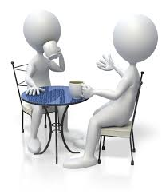
Relationship Management
Page 9
Ability to use awareness of your emotions and those of others to manage interactions successfully
e.g., resist saying something negative about a colleague in public that may embarrass them
Notes:
Time: 1 min used / 14 min remaining
SAY: The art of relationships depends upon the skill of managing emotions in others. When you understand another’s perspective, you are really understanding their needs.
CLICK

Slide 48
Relationship Management Strategies
Page 12
Be open and be curious
Remember the little things that pack a punch
Take feedback well / Make your feedback direct and constructive
Build trust
Explain your decisions, don’t just make them
Notes:
Time: 3 min used / 11 min remaining
ASK: As we finish our discussion on this element, what are some strategies to use to develop Relationship Management ? Please post your ideas in Chat.
SAY: Here are some strategies that can be used to develop the Relationship Management element:
Facilitator Note: If there is not enough time to cover all of the points under each strategy, focus on sharing the content in italics.
Be open and be curious
Being open means sharing information about yourself with others.
You can use self-management skills to choose how open you are and what you share.
When people know more about you, there is less room for them to misunderstand you.
You also need to be interested in other people’s stories as well.
Remember the little things that pack a punch
Begin to make the habit of incorporating more expressions of Appreciation and Encouragement (i.e., “Thank You!”, “Please”, “I’m sorry”) into your relationships
Take feedback well / Make your feedback direct and constructive
Use your Social Awareness skills to listen and hear what is being said.
Use your Self-Management skills to determine the next steps. Take time to absorb and reflect on the feedback rather then immediately respondingThank the person for their willingness to share their feedback with you.
For our purposes with the Relationship Management strategy and giving feedback, it is a relationship-building event that requires all four of the EI skills.
Self-Awareness = Identify your feelings about the feedback
Self-Management = don’t ignore giving feedback because of your discomfort. Understand what is causing that discomfort.
Self-Awareness = think about the person receiving the feedback. Feedback is meant address a behavior not the person.
Effective feedback is about sharing information and offering solutions for change.
Build trust
Trust is something that takes time to build, can be lost in seconds, and may be the most important and most difficult objective in managing relationships.
How is trust built? Open communication. Willingness to “be open and be curious”. Consistency in words, behaviors, and actions. Reliability in follow through.
Use your Self-Awareness/Self-Management skills to share a bit of yourself with the other person.
Use your Social Awareness skills to ask the other person what they need for trust to be happen.
Explain your decisions, don’t just make them
People appreciate the transparency and openness. This build trust, respect, and connection.
However, for this purpose, it is important to take time to explain the why behind decisions. This includes sharing the alternatives and why the final choice made the most sense, rather than just implementing a change and expecting others to accept it.
It is important to ask for ideas from the team if possible, depending on the situation.

Slide 49
Putting It All Together
Page 13
Envisioning Our Future
Fundamentals of Communication
Emotional Intelligence
Why is applying Respect for People, Fundamentals of Communication, and Emotional Intelligence important in your role as a UW Health employee?
Notes:
Time: 1 min used / 10 min remaining
SAY: In this class and the last class we have covered the Respect for People foundation. “Why is applying Respect for People, Fundamentals of Communication and Emotional Intelligence important in your role as a UW Health leader?

Slide 50
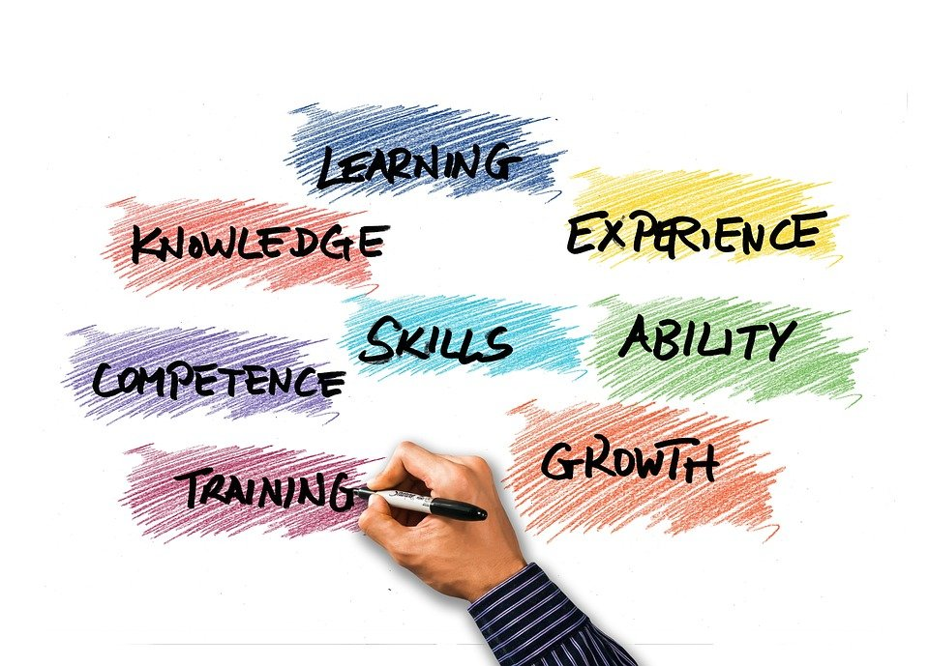
Continued Learning Activities

Slide 51
70-20-10 Learning Model
10%
Formal Learning
Learning courses, certifications, continuing education, reading a book
70%
Learning from Experience
20%
New responsibilities, tasks, project assignment
Learning from Others
Go and Sees, coaching, mentoring, observing others, soliciting feedback
Notes:
SAY: The Continued Learning Activities are part of the from 20% of your learning from others and 70% of your learning from challenging experiences and assignment

Slide 52
Continued Learning
Page 13
During your next department meeting, be prepared to share an example of when you applied one of the Fundamentals of Communication or Emotional Intelligence strategies in your work.
What were the benefits of applying this strategy?
Notes:
Time: 1 min used / 9 min remaining
SAY: During your next Rounding or Huddle with your team and/or leader, be prepared to share an example of when you applied one of the commitments in your work. What were the benefits of demonstrating this commitment?

Slide 53
Additional Resources
Page 13
Visit the Respect for People Suite of Activities and Resources to continue the conversation with your team.
There are materials available to support your team in developing and demonstrating the behaviors connected to each of the commitments and other resources connected to the topics covered in today’s learning session.
Notes:
Facilitator:
Time: 1 min used / 6 min remaining
SAY: Visit the Respect for People Suite of Activities and Resources to continue the conversation with your team.
Facilitator Note: Click on link to show the site
There are materials available to support your team in developing and demonstrating the behaviors connected to each of the commitments and other resources connected to the topics covered in today’s learning session.

Slide 54
What is one key takeaway from today’s session?
Notes:
Time: 3 min used / 6 min remaining

Slide 55
Thank You!
We would like your feedback!
Notes:
Time: 1 min used / 5 remaining
SAY: Thank you We have covered a lot of content today and would like your feedback. We appreciate your feedback. This session evaluation link has also been added to the calendar invite. Please take a moment to fill it out. We value your experiences and what you have to say.
Cut and paste the following statement into the chat:
We invite you to provide us feedback on your learning experience in today’s session
Please click the following link to provide us feedback: https://forms.office.com/r/yUb3DCZZgb

